Slide 1
Build Application with Spring Boot and Spring Data (NoSQL)

Slide 2
Objectives
Data Management
Implement CRUD (Create, Read, Update, Delete) operations to manage data effectively.
Utilize Spring Boot to map Java objects to MongoDB, simplifying data persistence and retrieval.
User Interface Development
Design and develop a user-friendly interface using SpringMVC, enabling seamless interaction with the application.
Implement features such as form input validation, error handling, and feedback mechanisms to enhance user experience.

Slide 3
Build CRUD Application with Repository Pattern using SpringMVC + Spring Data Mongo

Slide 4
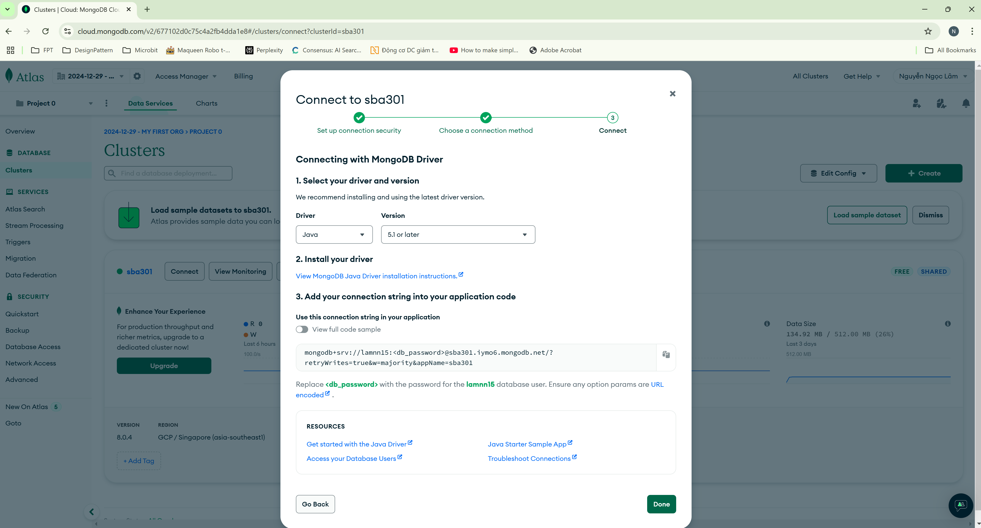
Open MongoDB Atlas

Slide 5
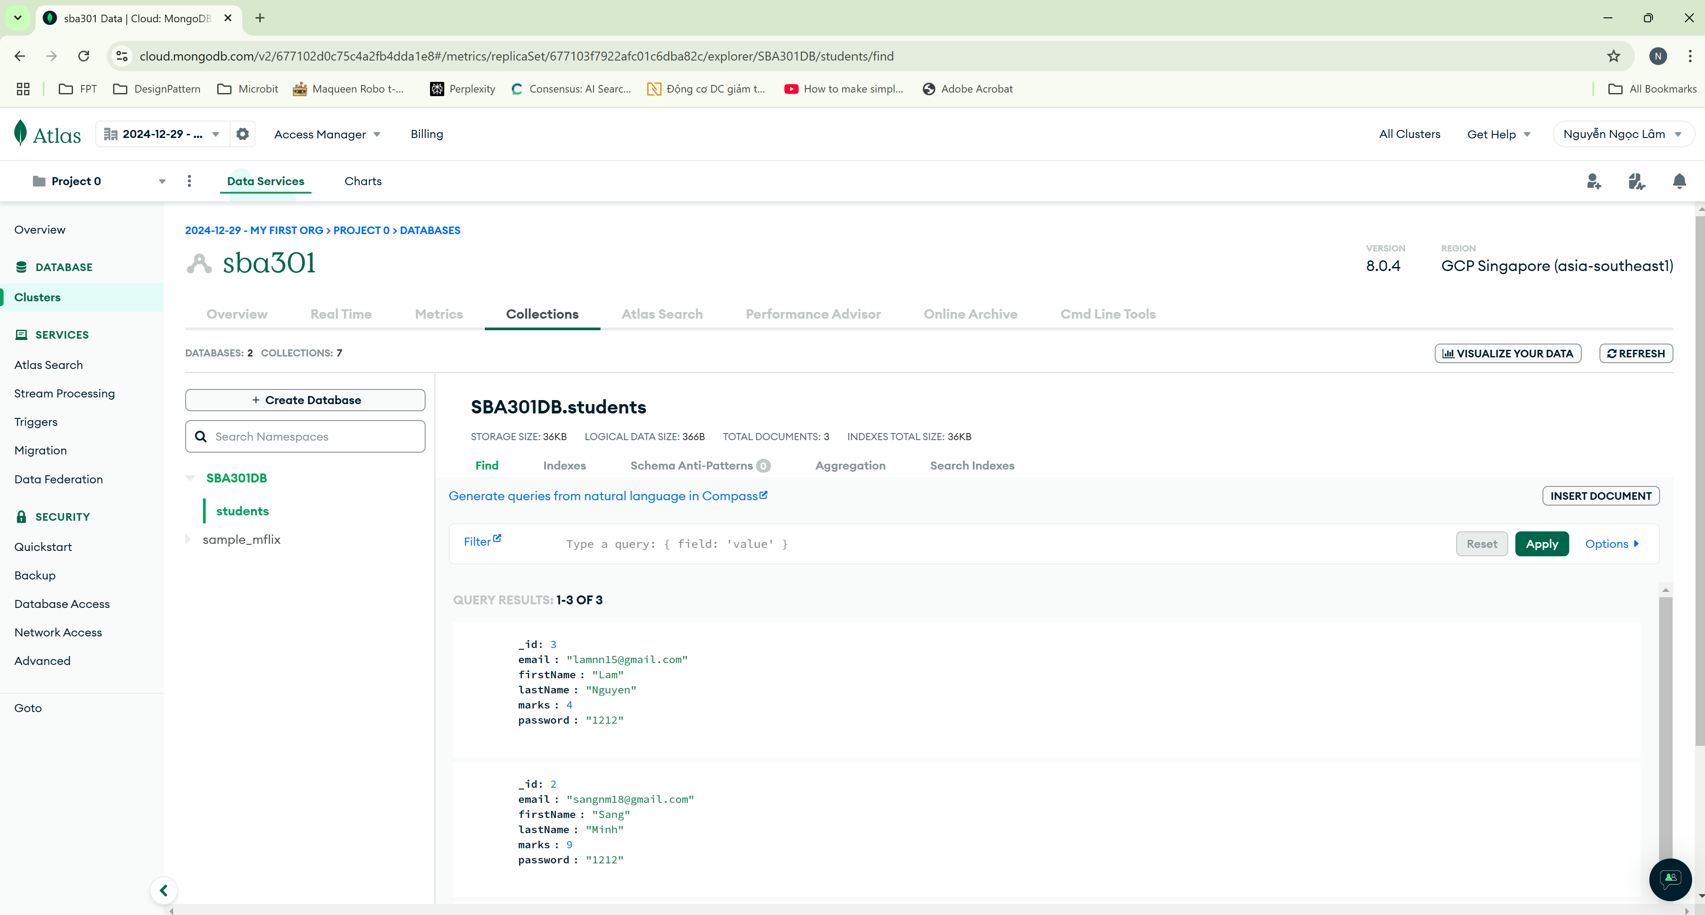
Create a database

Slide 6
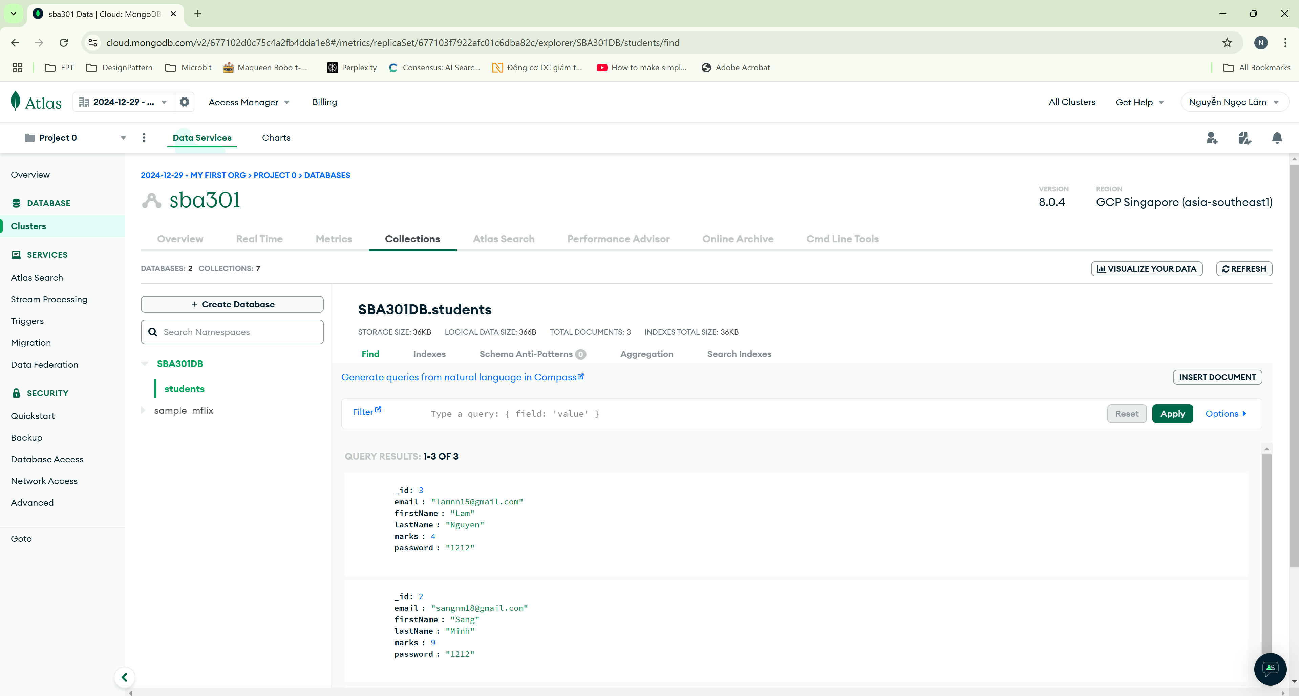
Create collections

Slide 7
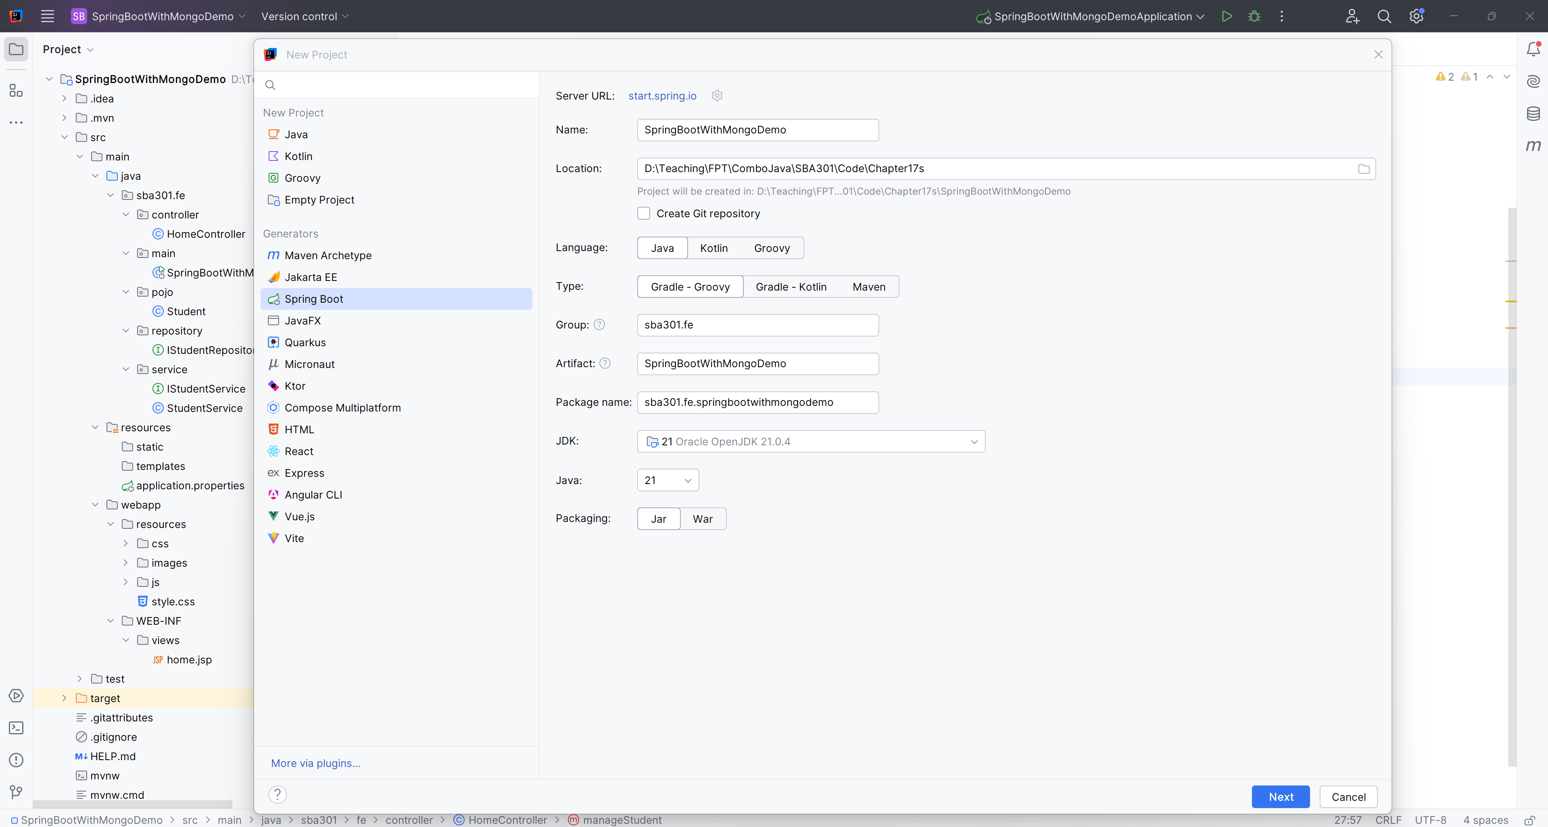
File New Project

Slide 8
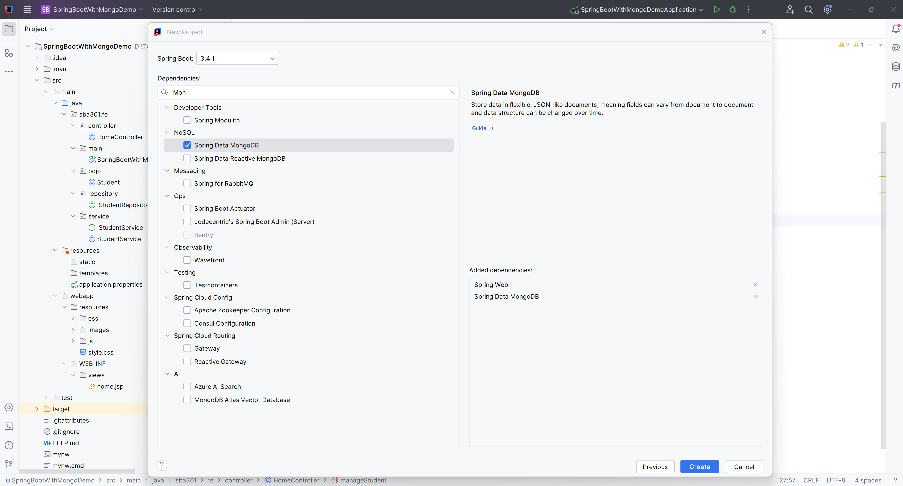
Add Dependences

Slide 9
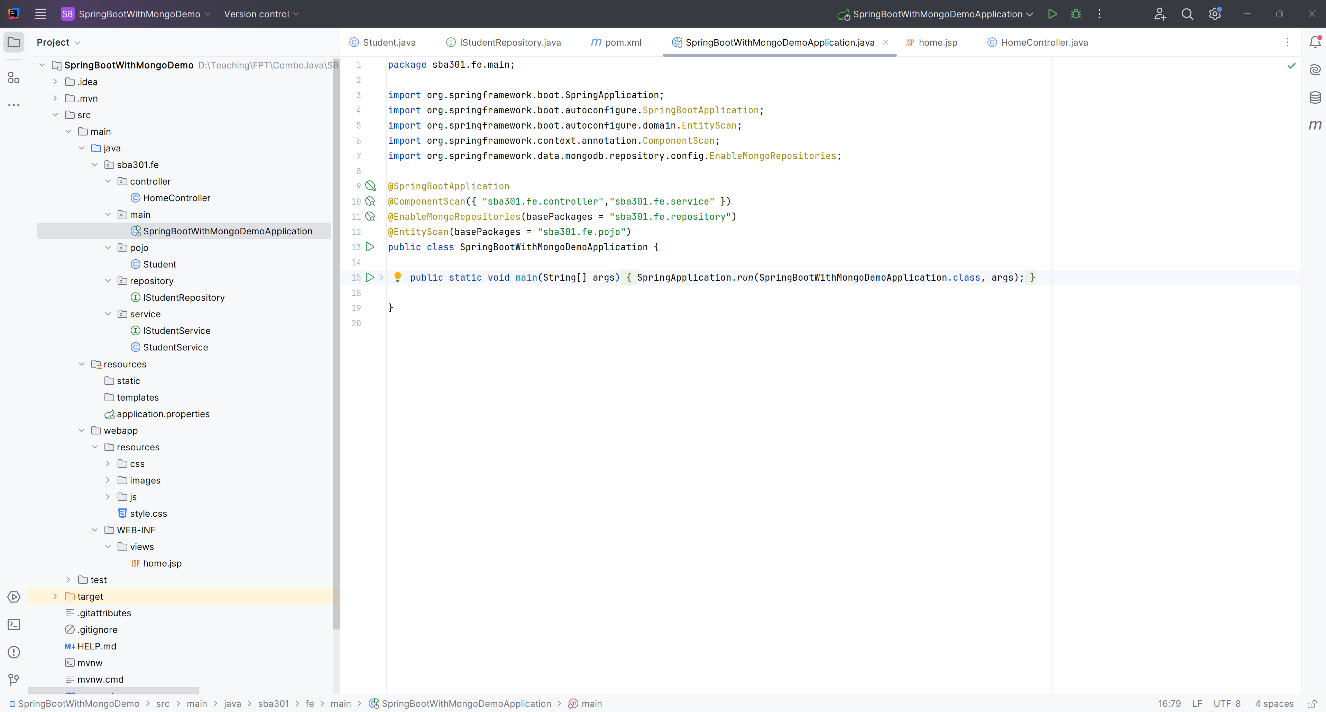
Create the Structure Project

Slide 10
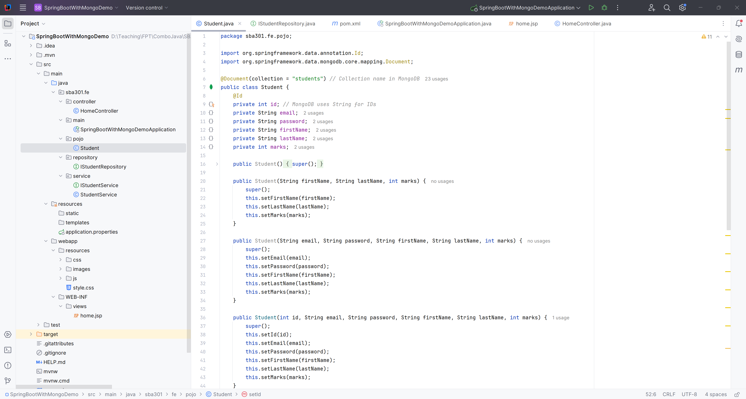
Create Student.java

Slide 11
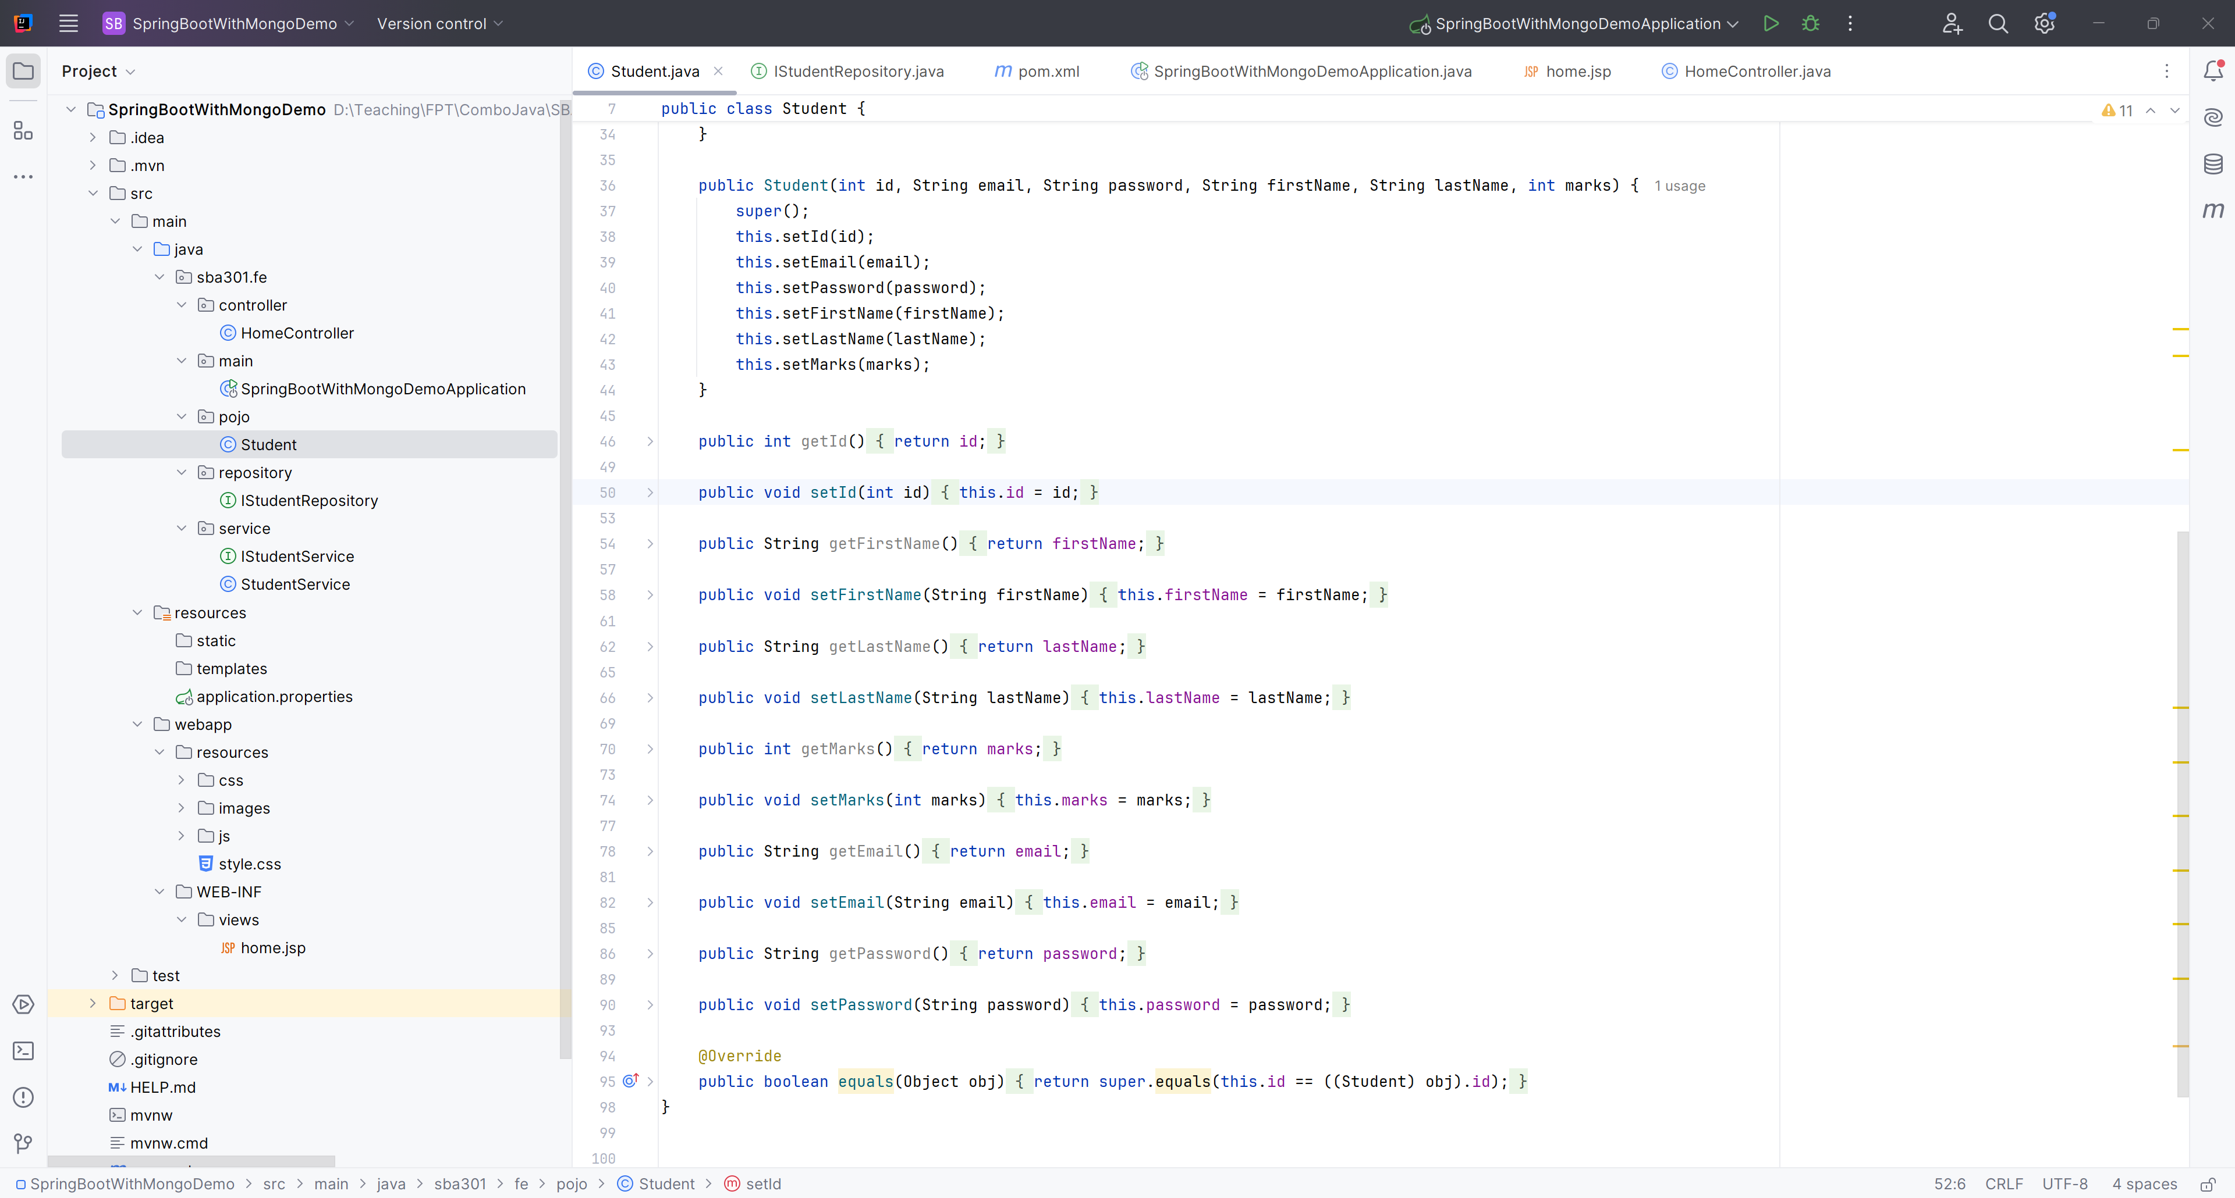
Create Student.java

Slide 12
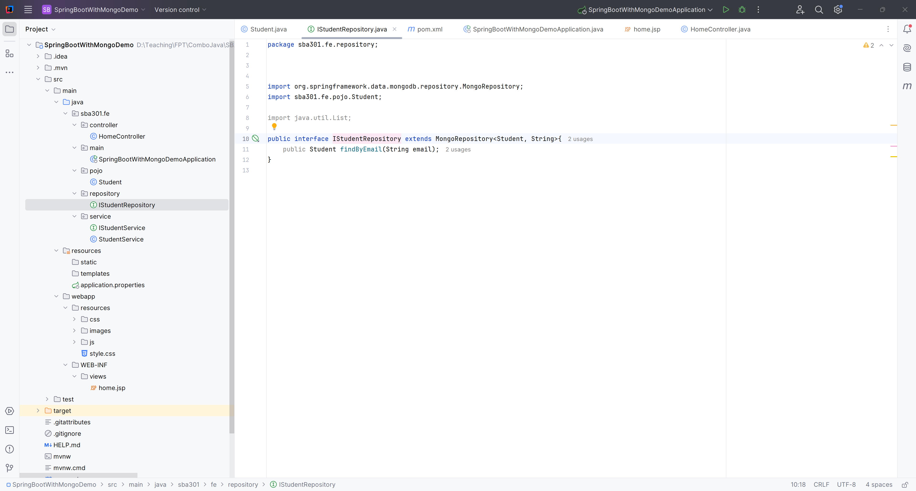
Create IStudentRepository

Slide 13
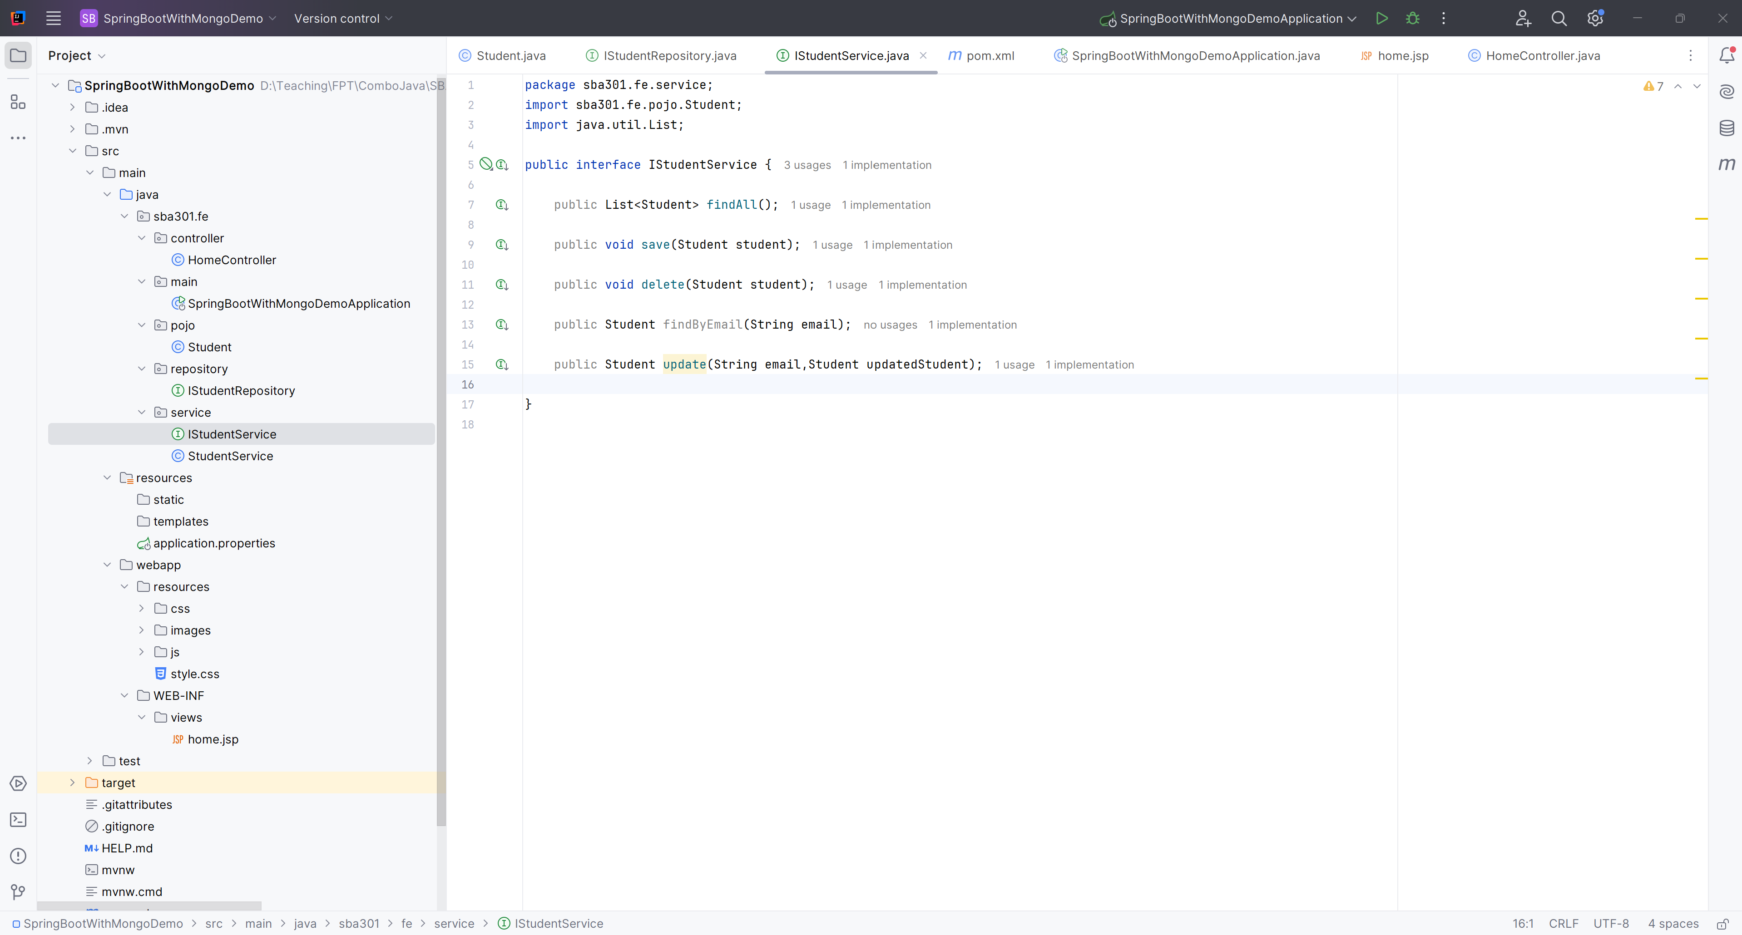
Create IStudentService

Slide 14
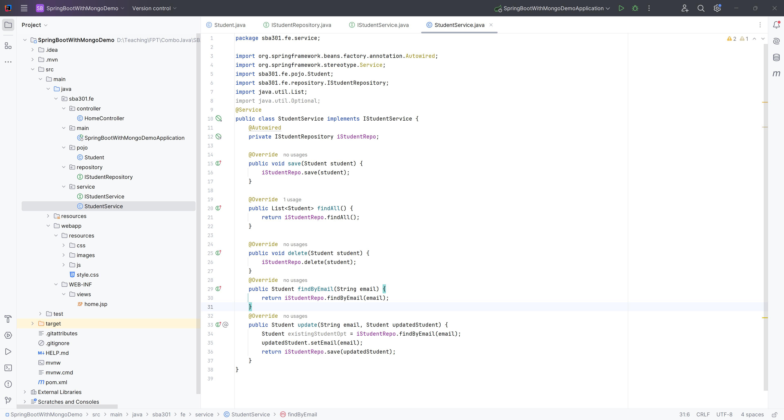
Create StudentService

Slide 15
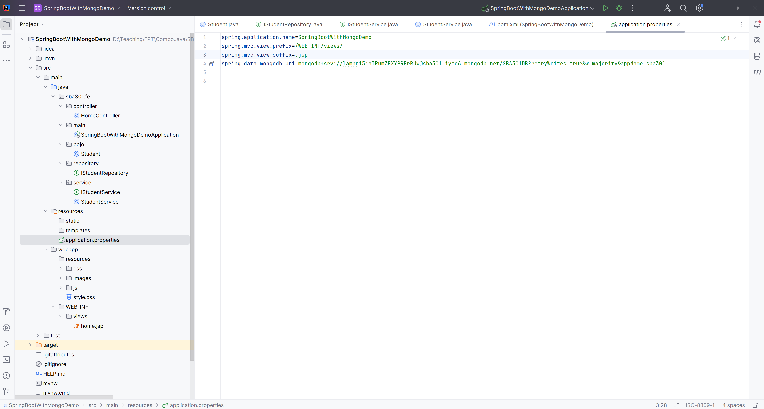
Edit application.properties

Slide 16
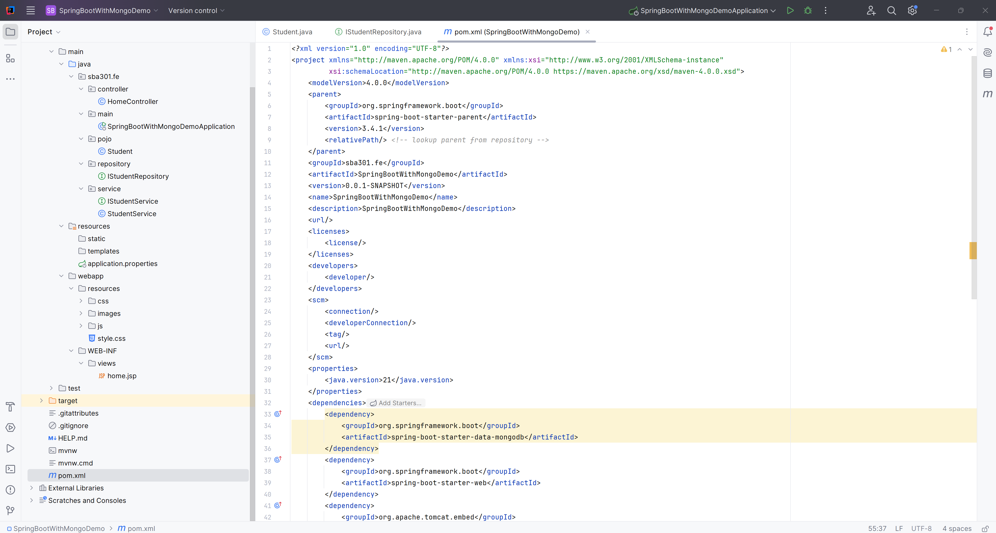
Edit pom.xml

Slide 17
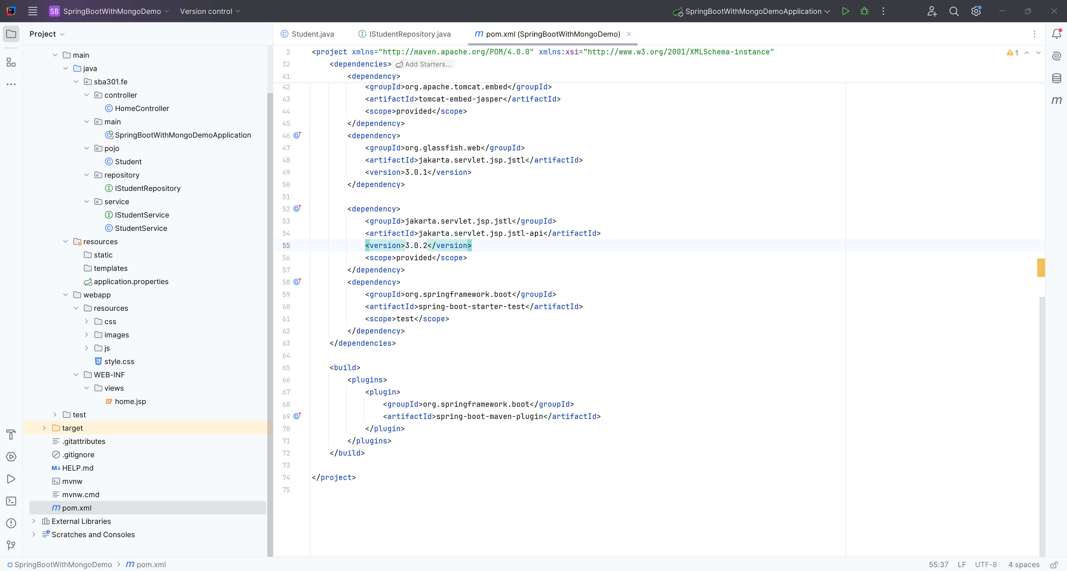
Edit pom.xml

Slide 18
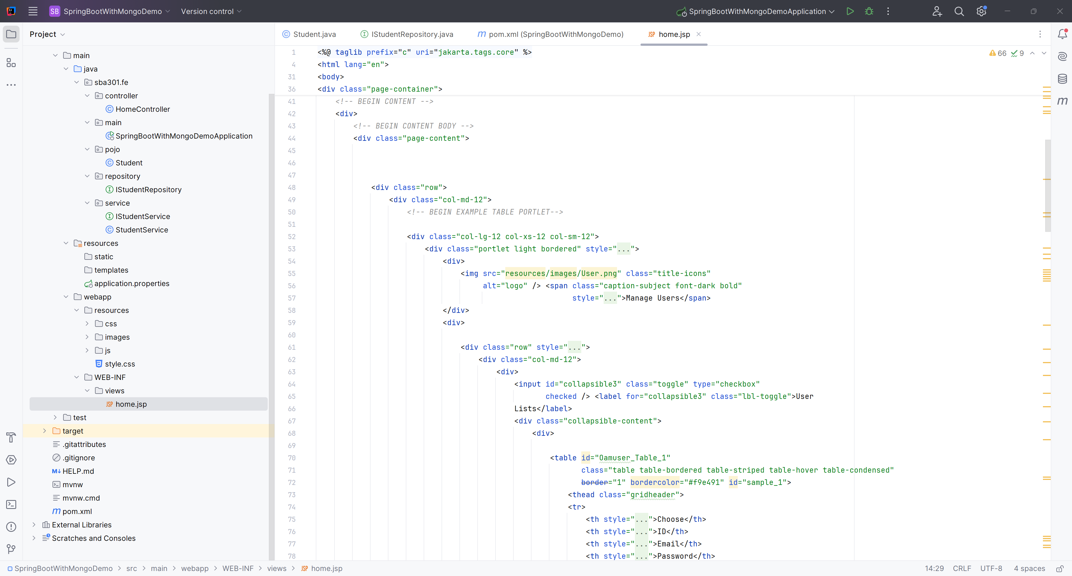
Edit home.jsp

Slide 19
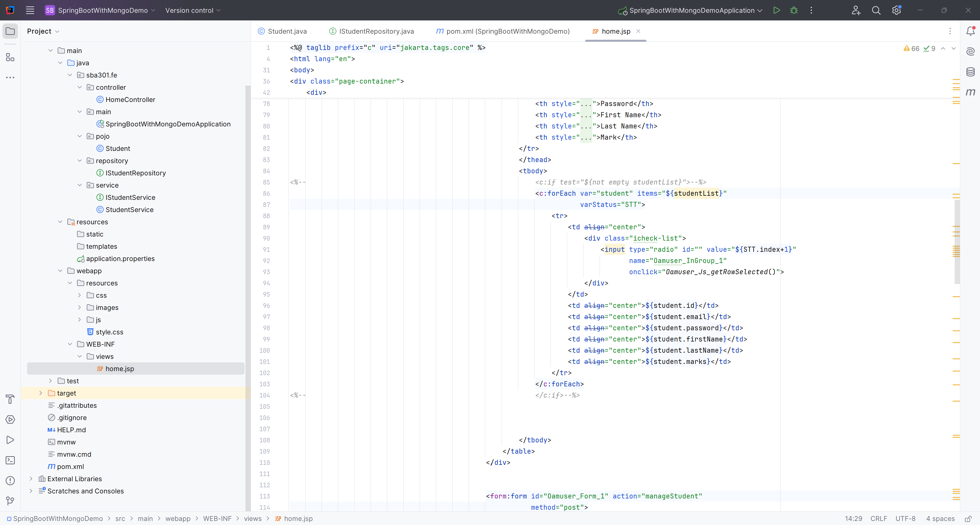
Edit home.jsp

Slide 20
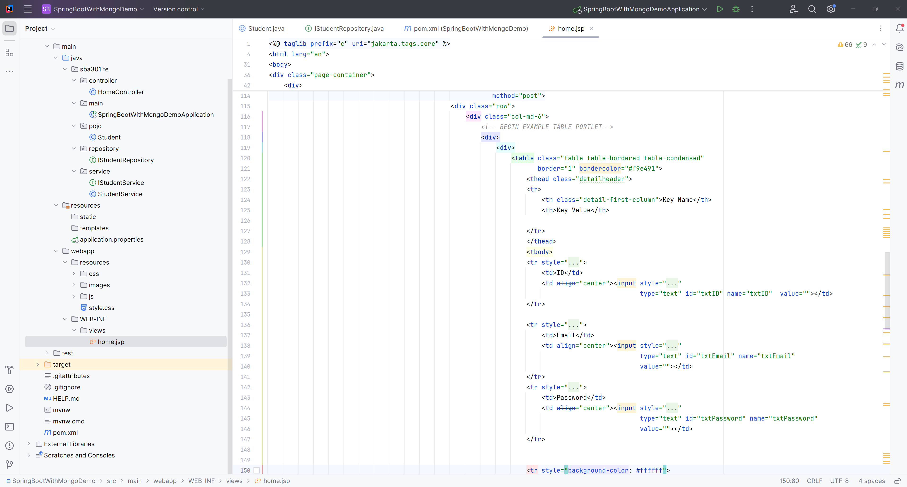
Edit home.jsp

Slide 21
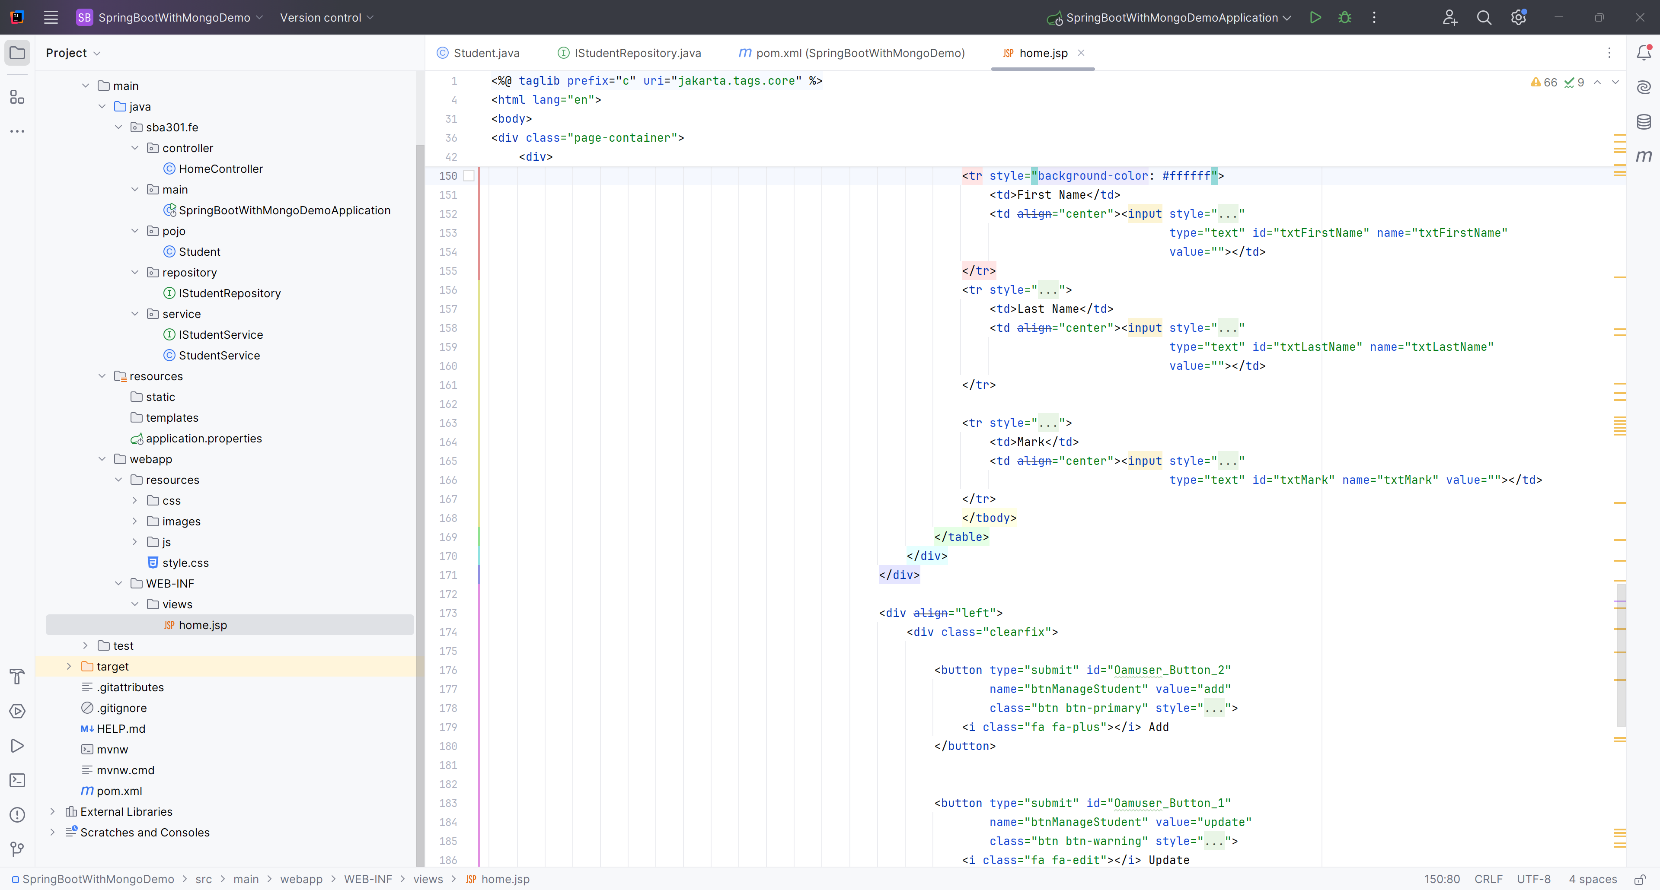
Edit home.jsp

Slide 22
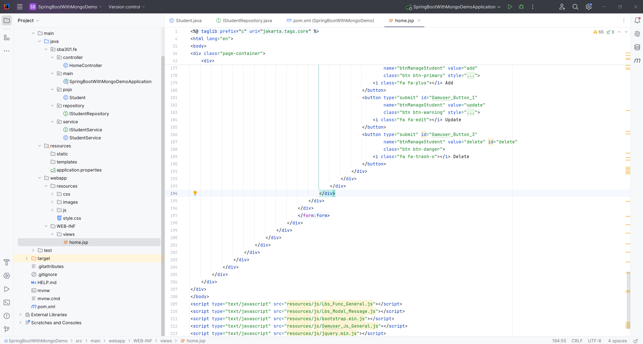
Edit home.jsp

Slide 23
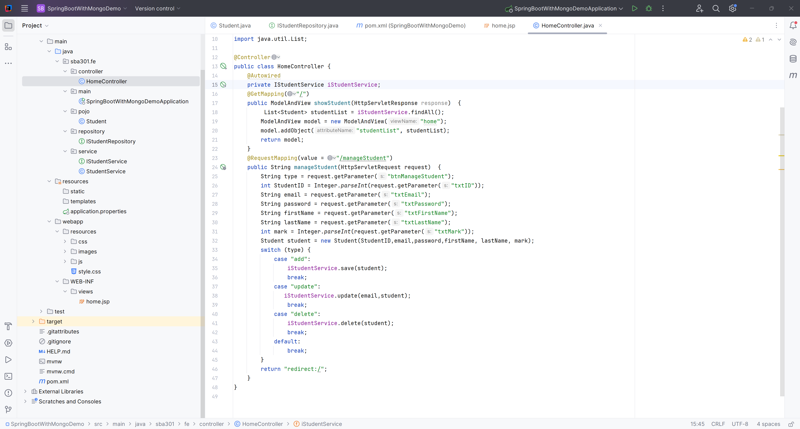
Edit the HomeController.java

Slide 24
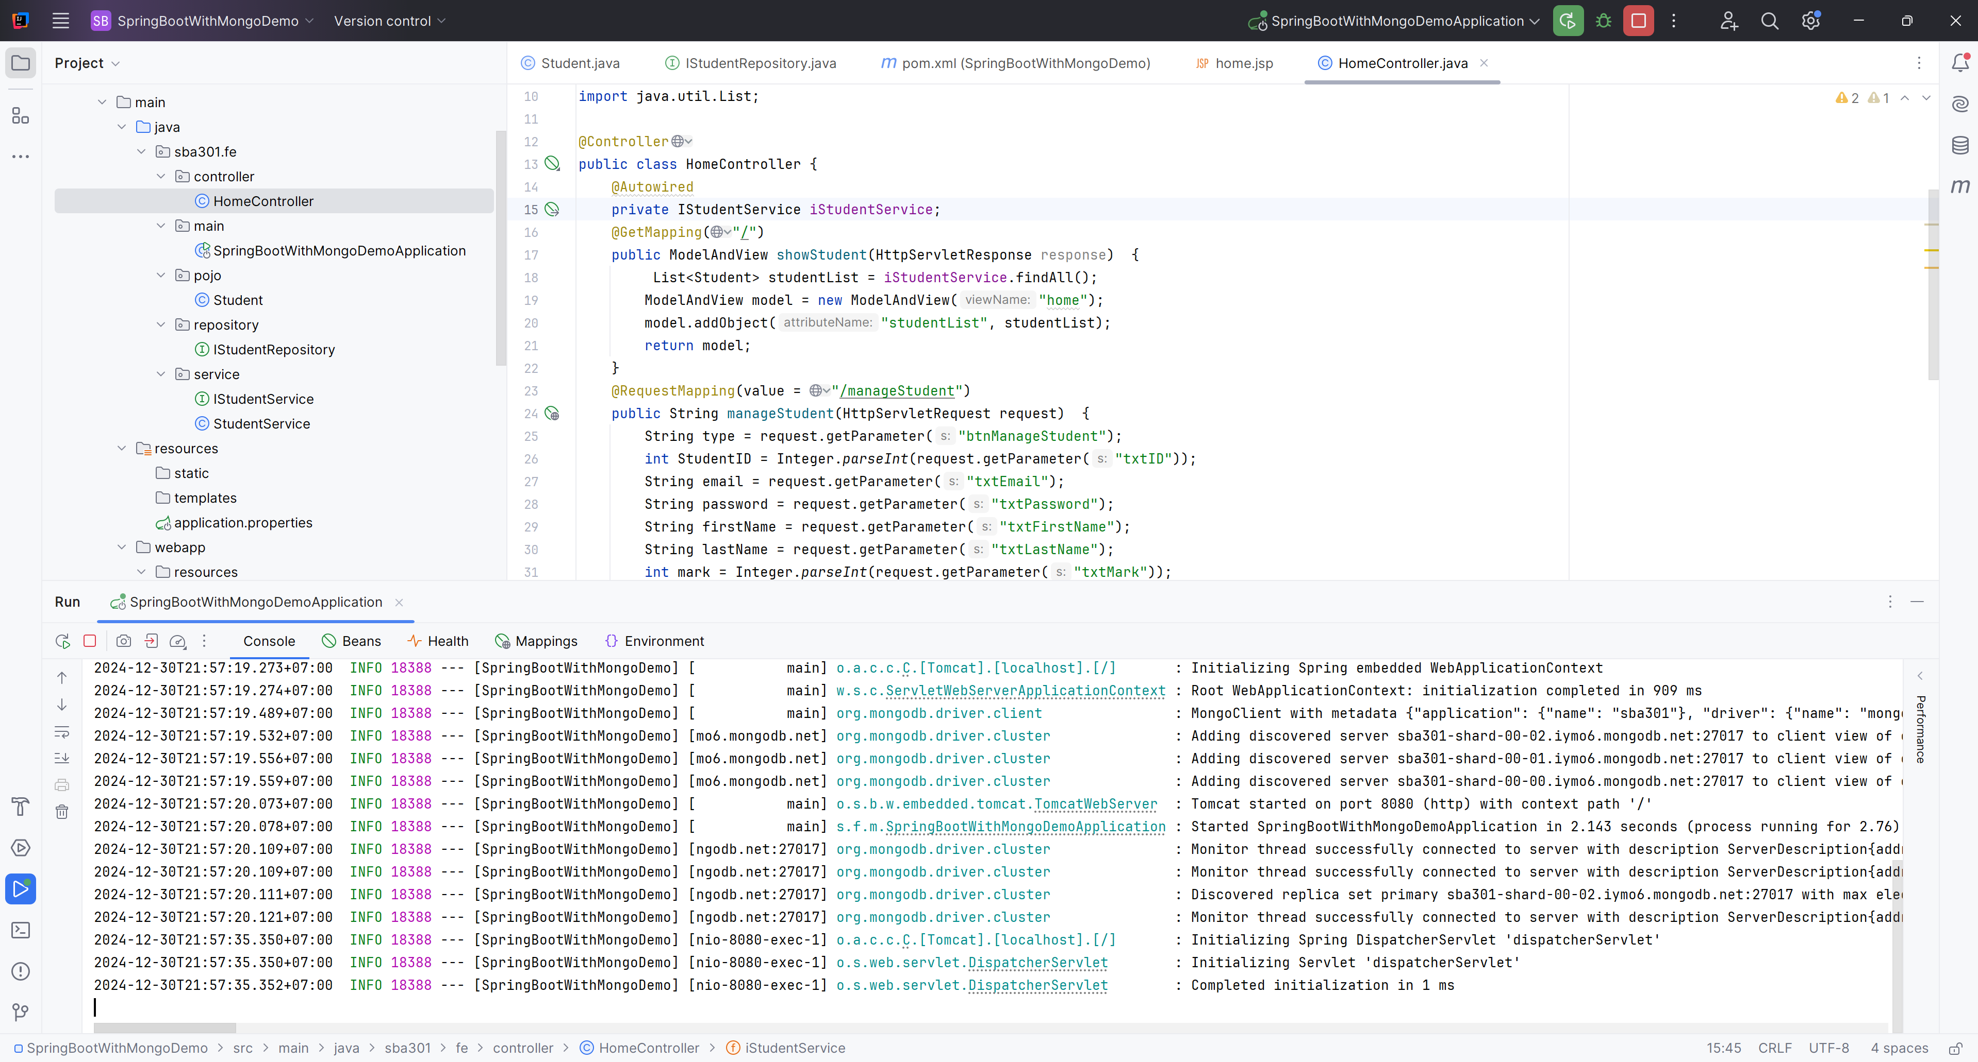
Run Project

Slide 25
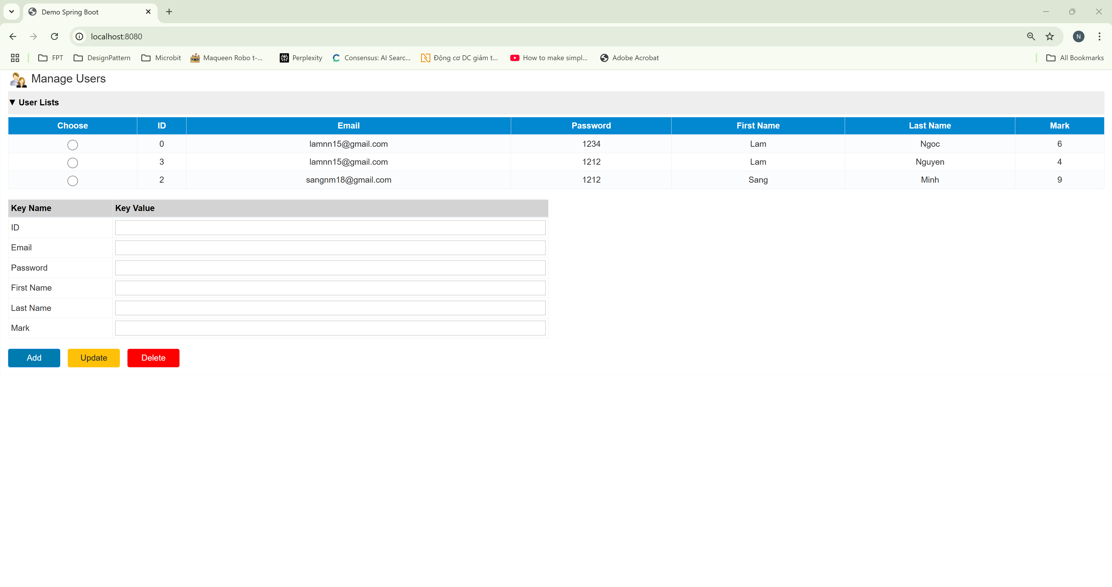
Show users

Slide 26
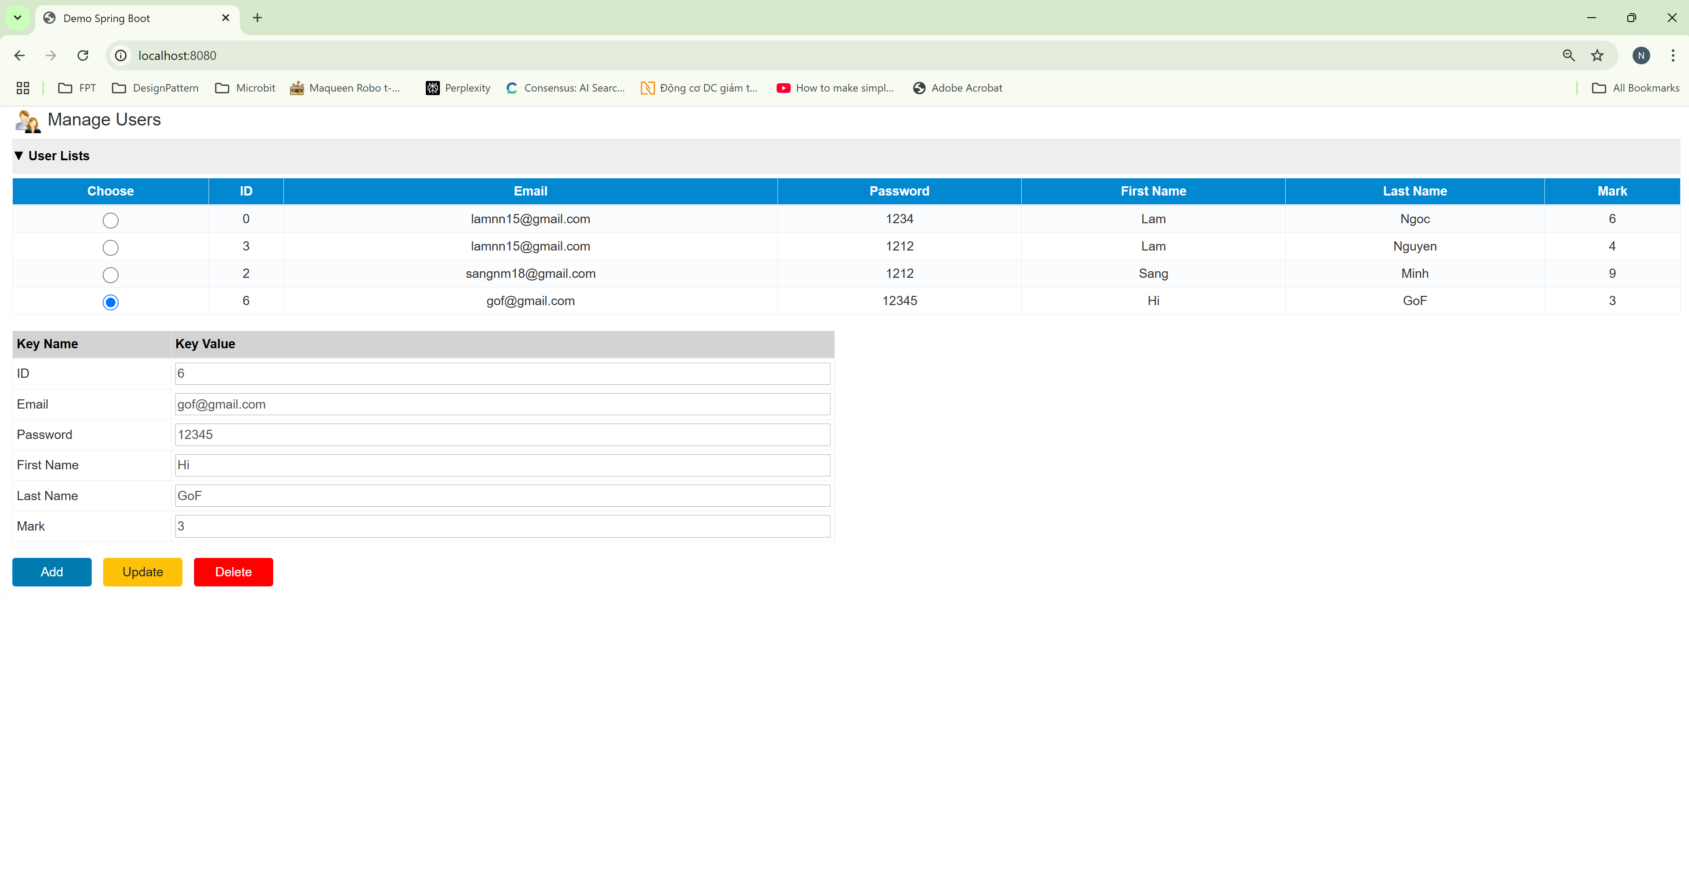
Add user

Slide 27
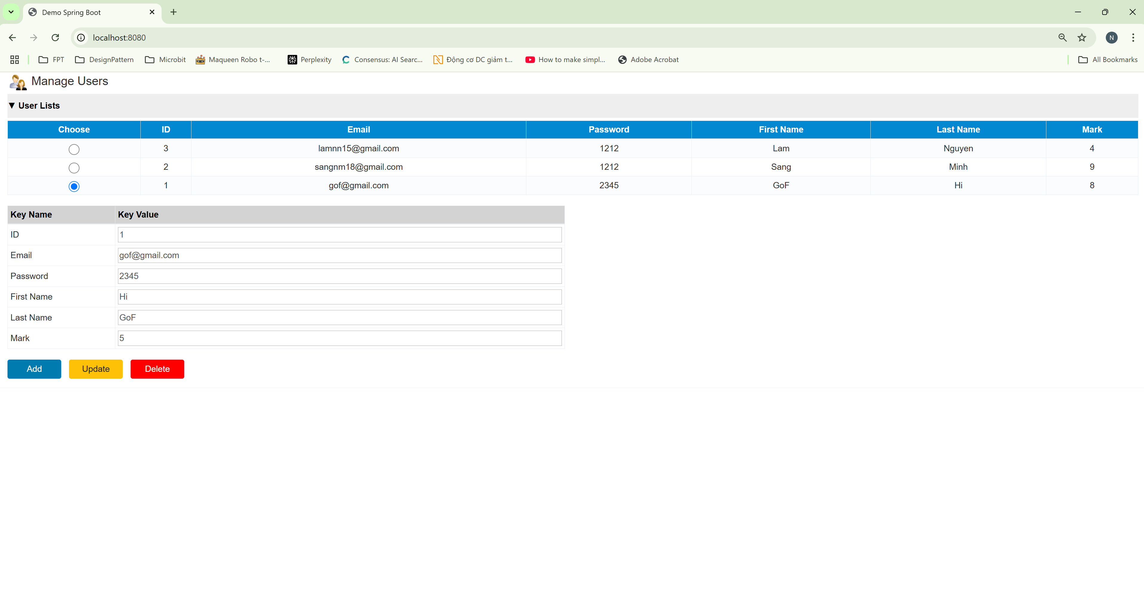
Edit the user

Slide 28
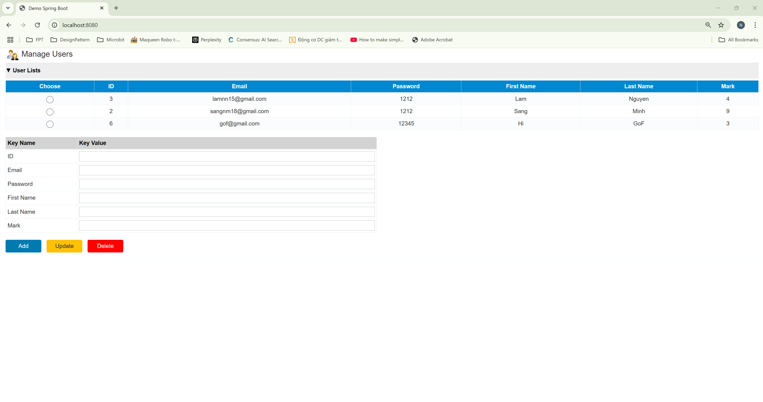
Delete the user

Slide 29
Summary
Concepts were introduced:
Implement CRUD (Create, Read, Update, Delete) operations to manage data effectively.
Utilize Spring Boot to map Java objects to Spring Data MongoDB, simplifying data persistence and retrieval.
Design and develop a user-friendly interface using Spring MVC, enabling seamless interaction with the application.
Implement features such as form input validation, error handling, and feedback mechanisms to enhance user experience.

